Slide 1
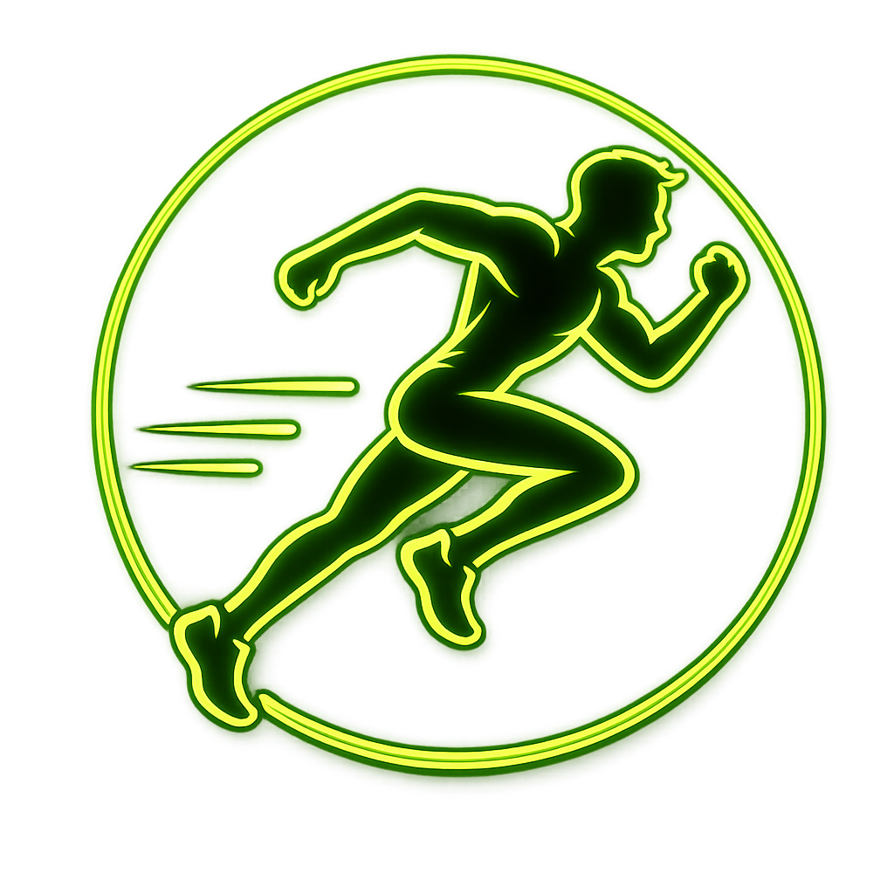
AI • COMPUTER VISION • SPORTS
Sports Injury
Risk Detection
from Video
An end-to-end web application for athlete movement analysis and injury-risk insights.
Presented by
Sejal Chintala

Slide 2
Problem Statement
02
Why video-based injury-risk monitoring can support safer training
THE CHALLENGE
CURRENT LIMITATIONS
PROPOSED SOLUTION
Athletes perform repetitive, high-intensity movements where poor technique or unusual joint movement may contribute to injury risk.
Manual observation alone can be difficult to perform consistently across every training session.
• Coach availability is limited
• Manual video review is time-consuming
• Movement changes may be missed
• Assessment can be difficult to standardize
Build a web-based pipeline that accepts a sports video, extracts pose information, analyzes movement and produces interpretable injury-risk insights and recommendations.

Slide 3
Project Objectives
03
The system is designed around six practical goals
01 Video Input
02 Pose Detection
03 Movement Analysis
Upload sports-performance videos through the application.
Extract human body landmarks from video frames.
Use joint information to study movement quality.
04 Risk Assessment
05 Athlete Management
06 Reports & History
Combine prediction and anomaly signals into risk insights.
Maintain athlete profiles and connect them to analysis.
Store analysis history and generate useful reports.

Slide 4
Methodology
04
A clear pipeline from raw video to athlete insight
1
2
3
4
5
6
Upload
Process
Analyze
Predict
Score
Report
Video file
Frames + pose
Joint angles
Risk signals
Overall risk
Recommendations
Analysis Layer
Pose landmarks → joint-angle information → movement quality → injury prediction → anomaly detection → risk score → corrective recommendations.

Slide 5
System Architecture
05
Frontend, API layer and analysis services work as one pipeline
FRONTEND
FASTAPI BACKEND
AI / ANALYSIS SERVICES
React.js
• Login / registration
• Coach dashboard
• Athlete management
• Video upload
• Analysis & history
REST API
• User / athlete APIs
• Video upload endpoint
• History endpoint
• File handling
• Response to frontend
• OpenCV video processing
• MediaPipe pose landmarks
• Joint-angle analysis
• Injury prediction
• Anomaly detection
• Risk scoring
• Recommendations
• PDF report

Slide 6
Technology Stack
06
Technologies selected for a practical end-to-end implementation
React.js
FastAPI
Python
Frontend
Component-based UI and interactive dashboards.
Backend
Python API framework for application endpoints.
Analysis
Core language for processing and AI services.
OpenCV
MediaPipe
Git / GitHub
Computer Vision
Video capture, frame processing and thumbnails.
Pose Estimation
Human pose landmarks for movement analysis.
Development
Version control and collaborative workflow.

Slide 7
Core Features
07
Key modules implemented in the application
Athlete Management
Coach Dashboard
Register and maintain athlete information.
View athlete and analysis-level information.
Video Upload
Pose Processing
Select an athlete and submit a performance video.
Process video and extract movement information.
Risk Analysis
Reports & History
Prediction, anomalies and risk scoring.
Persist analysis records and generate reports.

Slide 8
Implementation
08
How the working application handles athlete and video workflows
ATHLETE WORKFLOW
VIDEO WORKFLOW
1. User opens Athlete Management
2. Athlete profile is created with relevant details
3. Athlete records are displayed for monitoring
4. Coach can select an athlete during video upload
5. Analysis history can be associated with the selected athlete.
1. Select athlete + video
2. Backend receives multipart upload
3. Video is processed with computer vision
4. Joint angles and movement signals are generated
5. Risk prediction + anomaly detection are applied
6. Score, recommendations and report are returned

Slide 9
Results & Current Progress
09
Demonstrated functionality in the working prototype
WORKING COMPONENTS
OBSERVED OUTPUT
IMPORTANT NOTE
✓ Landing page and navigation
✓ User / role-based flow
✓ Athlete registration and listing
✓ Coach dashboard with live application data
✓ Video upload and backend integration
✓ Analysis response and history storage
✓ Report-generation workflow
The application is able to connect the user interface to the FastAPI backend, process submitted videos through the analysis pipeline, associate results with an athlete and expose the resulting information to the dashboard / analysis views.
The current project demonstrates the complete application workflow.
Model accuracy and clinical validity should be evaluated separately using a larger, representative dataset and formal validation.
No unsupported accuracy figure is claimed in this presentation.

Slide 10
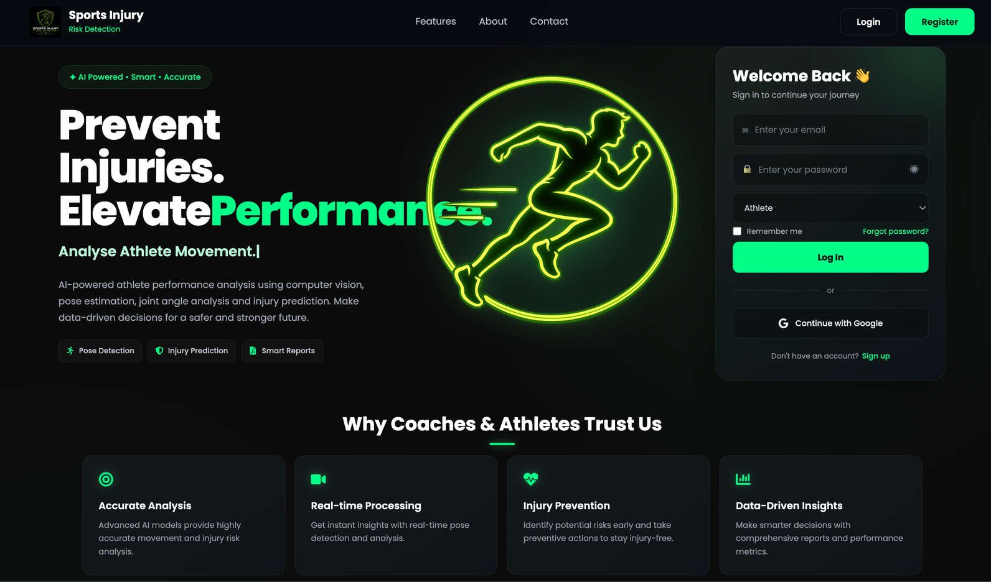
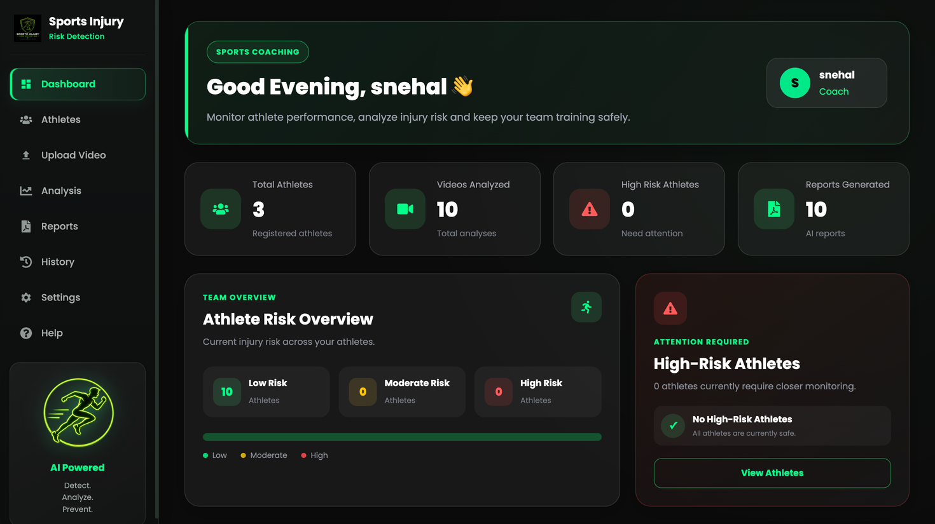
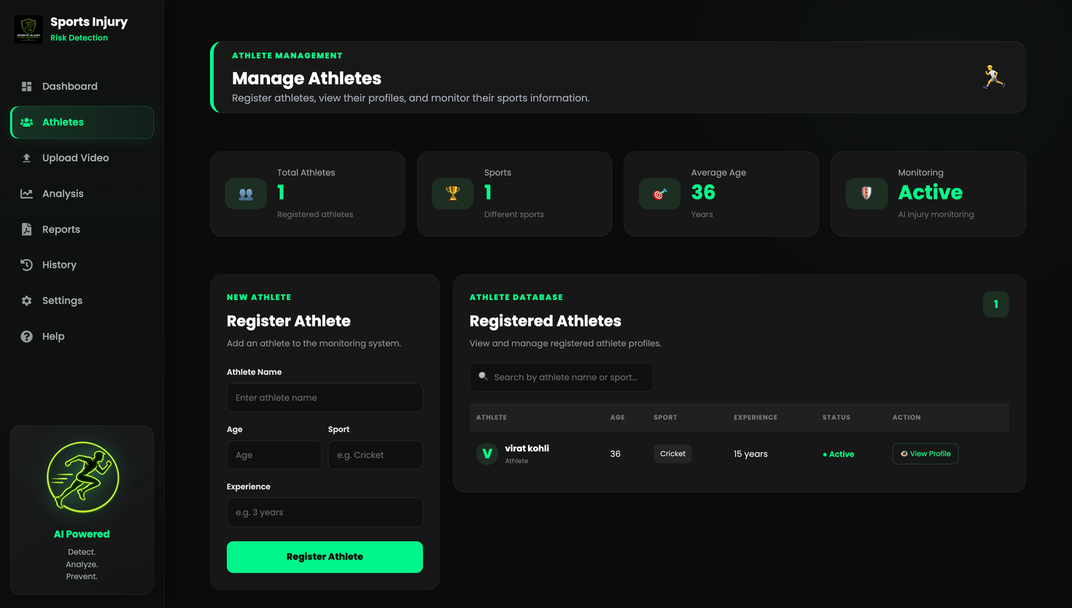
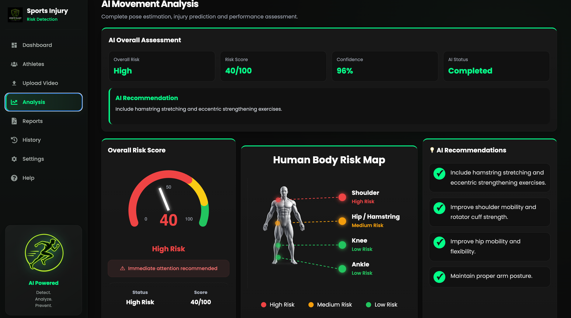
Application Screens
10
LANDING PAGE
COACH DASHBOARD
ATHLETE MANAGEMENT
VIDEO UPLOAD / ANALYSIS

Slide 11
Challenges, Future Scope & Conclusion
11
Development lessons and the next stage of the project
CHALLENGES
FUTURE SCOPE
CONCLUSION
• Integrating frontend and backend
• Maintaining athlete data across views
• Organizing video-processing services
• Connecting analysis outputs to UI
• Keeping the workflow simple for coaches
• Train / validate on larger datasets
• Add sport-specific movement models
• Real-time video analysis
• Personalized athlete risk profiles
• Richer visual analytics
• Improved report generation
The project combines web development and computer vision to create an end-to-end sports movement analysis workflow.
It provides a foundation for data-driven injury-risk monitoring and can be extended with stronger datasets and validated ML models.

Slide 12
Sports Injury Risk Detection from Video
Thank you

